Slide 1

Institute of Technology of Cambodia
Department Applies Mathematics and statistics
Project :
ANALYZING SOCIAL MEDIA MARKETING DATA WITH LINEAR REGRESSION
Group7: RA017

Slide 2
Group Member:
SEAN VENGNGY
e20201133
AOV KEATMENG
e20201812
MAO KIMLANG
e20201055
HIN BUNRA
e20201287

Slide 3
1
Introduction
Table Of Content
2
Method and Matherial
3
Result
4
Reference

Slide 4



Background information of project
In today's digital age, social media marketing is a type of digital marketing various social media platforms such as Facebook, YouTube and newspaper to promote products or services. It is increasingly being used by businesses of all sizes to reach their target audience and engage with customers in real-time.

Slide 5
1.1. Data preparation
In dataset we got form Datarium in R program the variables type is numerical. In the dataset we have 4 variables such as facebook, youtube, newspaper and sales. The target value is sales and Regressors are facebook, youtube and newspaper. And the method we are going to use are simple linear regression and multiple linear regression.
The research question what's my team focus is "What is the effect of Facebook advertising on the company’s sales, given the effects of YouTube and newspaper advertising?"

Slide 6


2 . METHODS AND MATERIALS
We use a lot of tools and method to solve and try to analyst data to ensure that we will get all insight information from dataset.
We choose some tools such as :
EDA
Statistical analysis
Multiple Linear regression
Simple linear regression

Slide 7
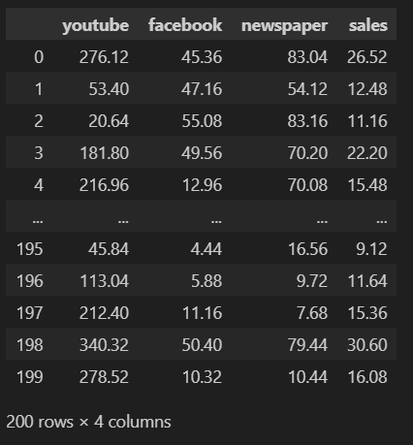
EDA
In dataset we got form Datarium in R program the variables type is numerical

Slide 8
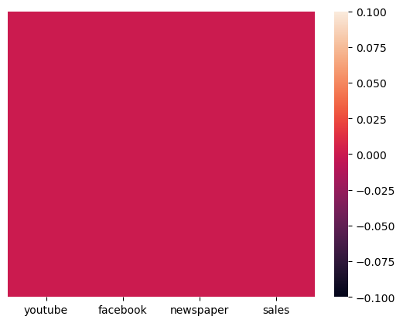
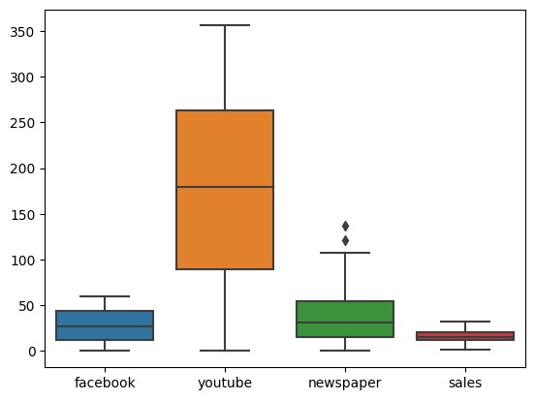
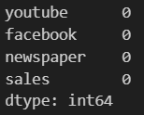
Checking on missing value by using heatmap and isnull().sum()
Checking outliier by boxplot

Slide 9
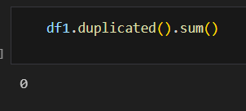
Checking on duplicate value

Slide 10
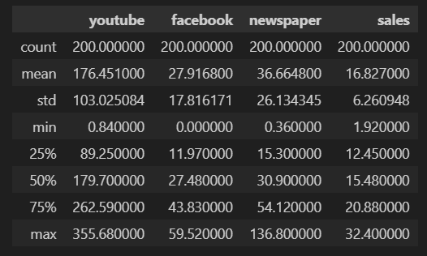
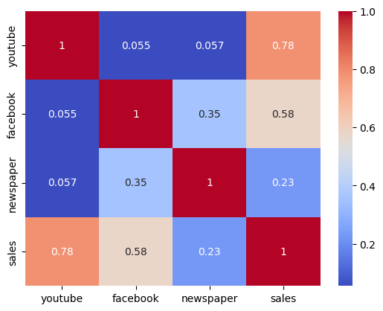
Describe the data - Descriptive statistics
Correlation

Slide 11
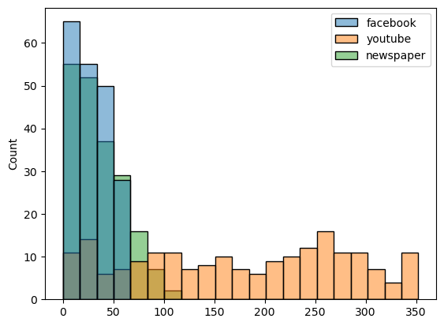
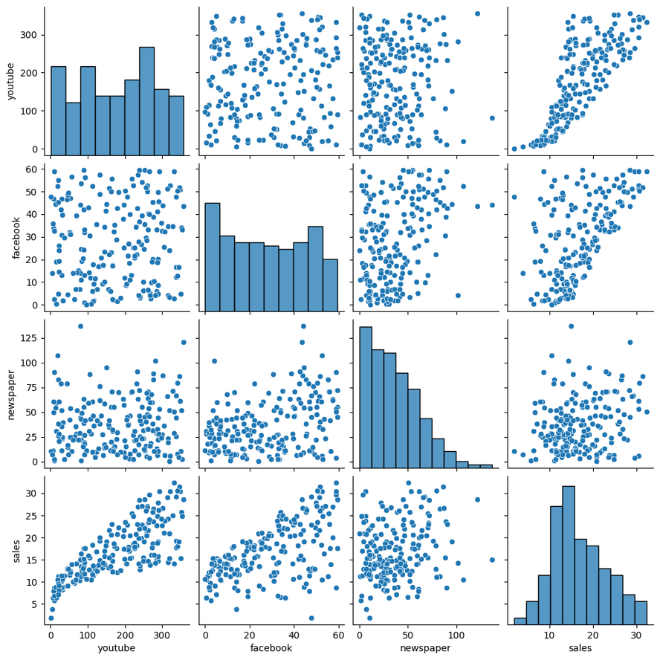
Show the history of data
Show the relationship between 2 variables

Slide 12
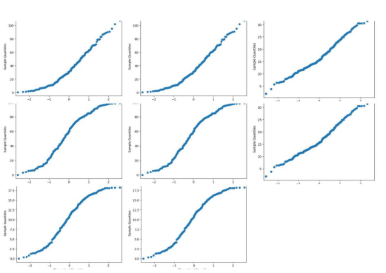
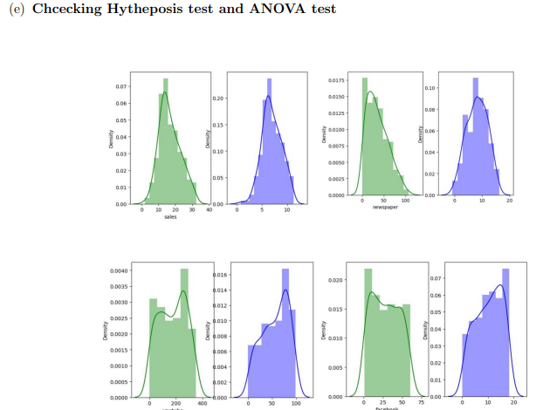
QQ plot
BoxCox transformation

Slide 13
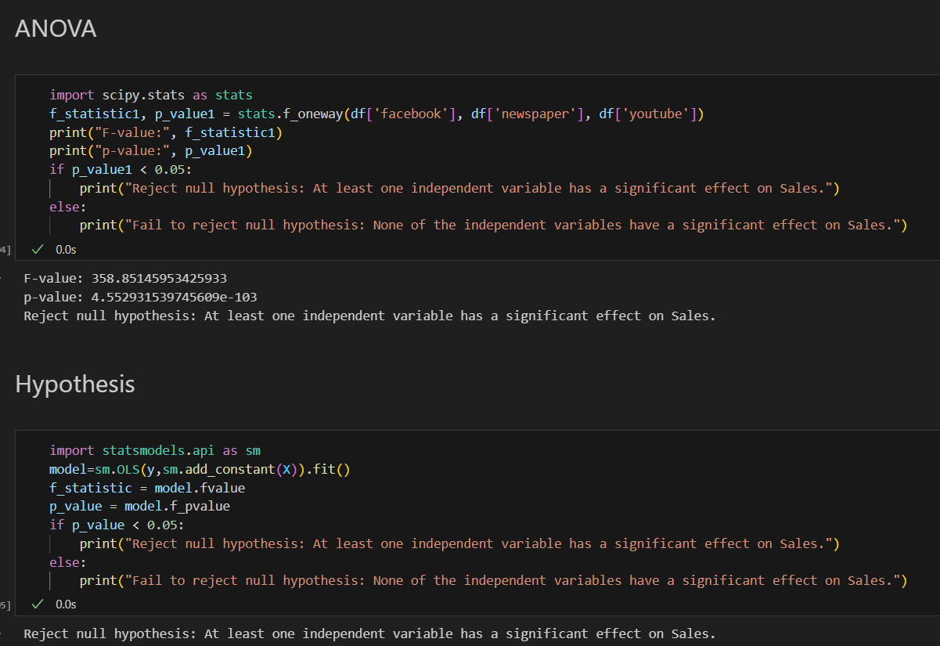
Statistical analysis
Checking interaction

Slide 14
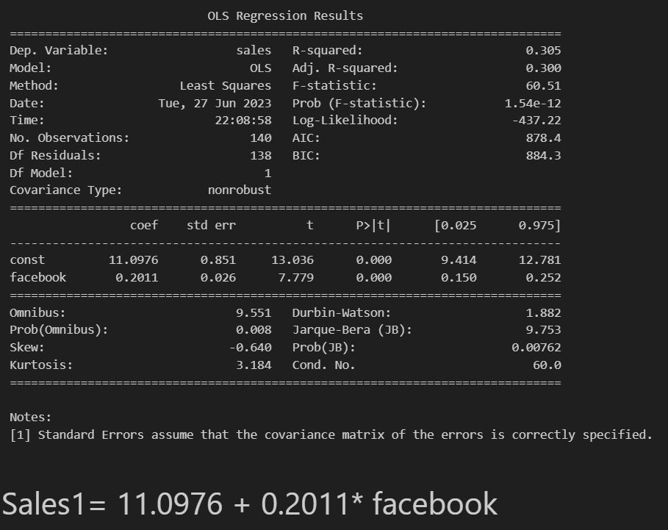
After we checking Hypothesis test and ANOVA test , we can see that at least one independent variables involves in the model. The confounder we had defined is newspaper.
The Simple Linear regression on each regressors.

Slide 15
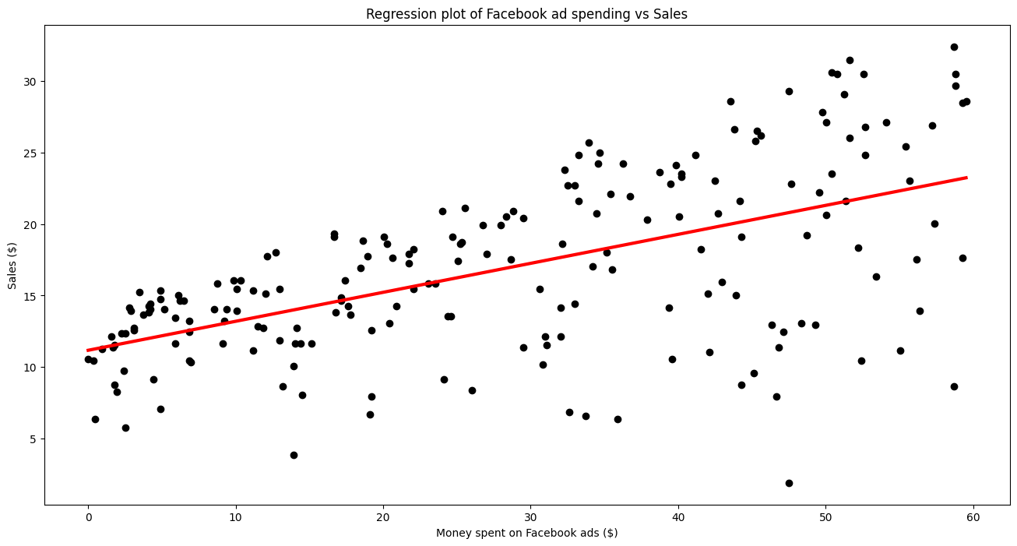

Slide 16
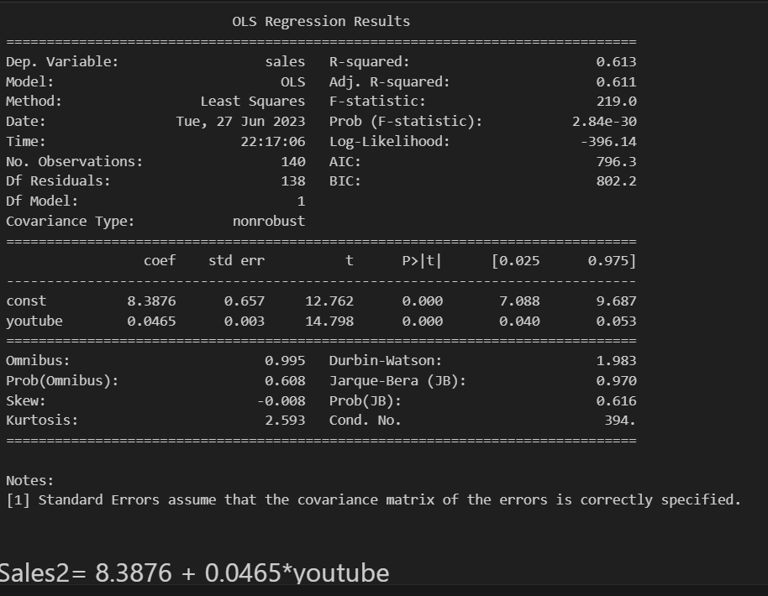
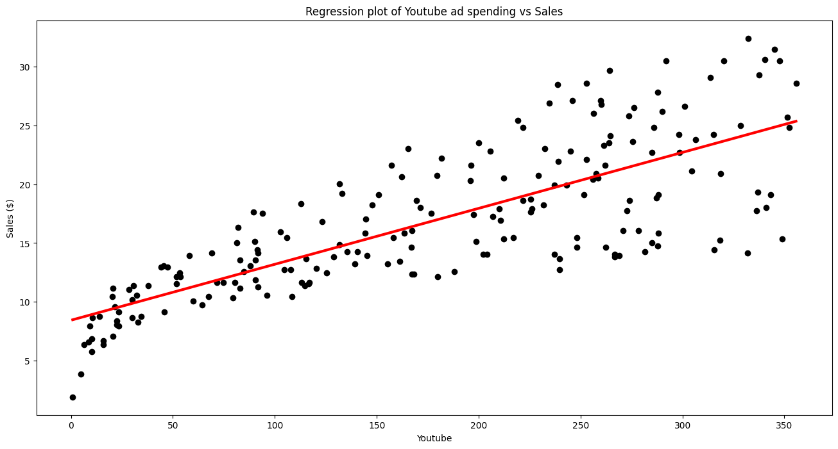

Slide 17
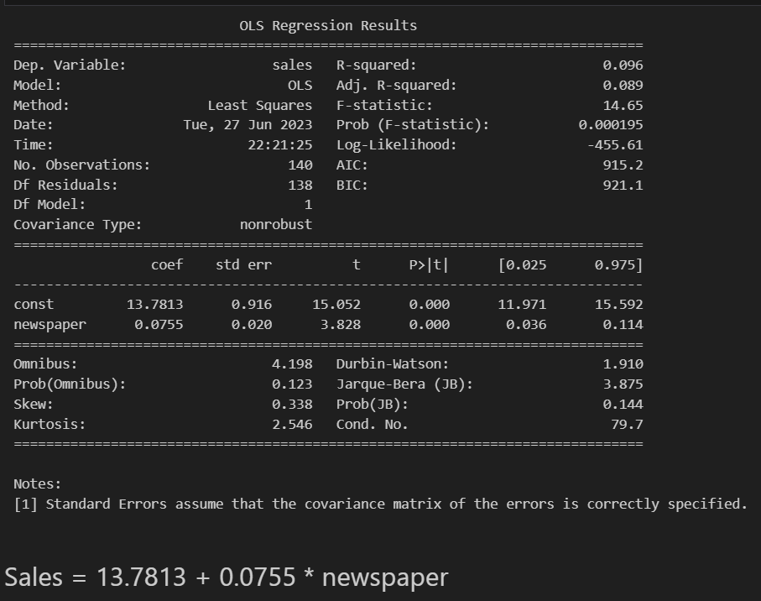
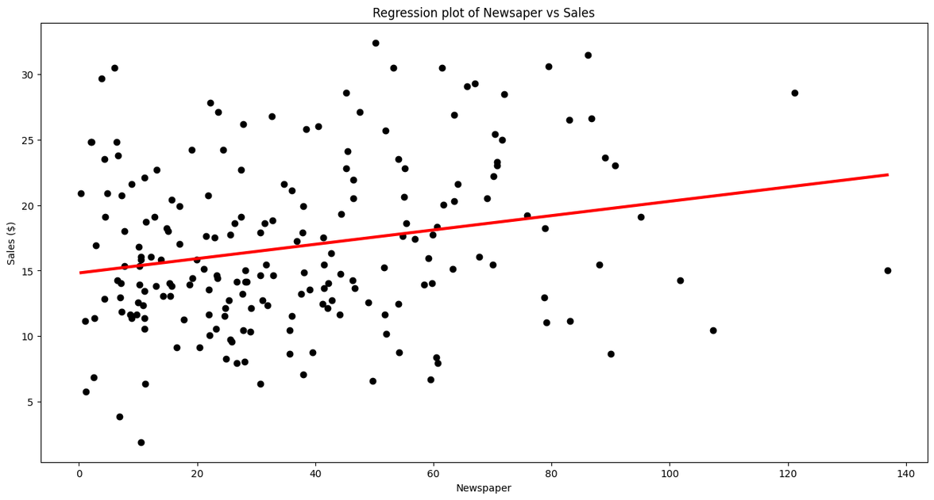

Slide 18
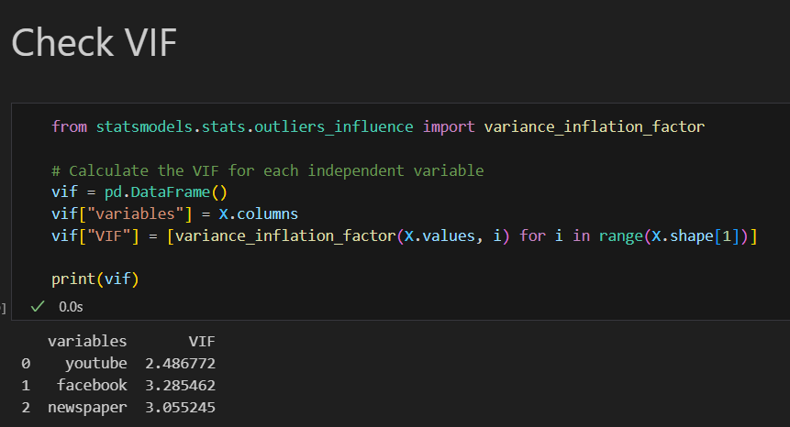
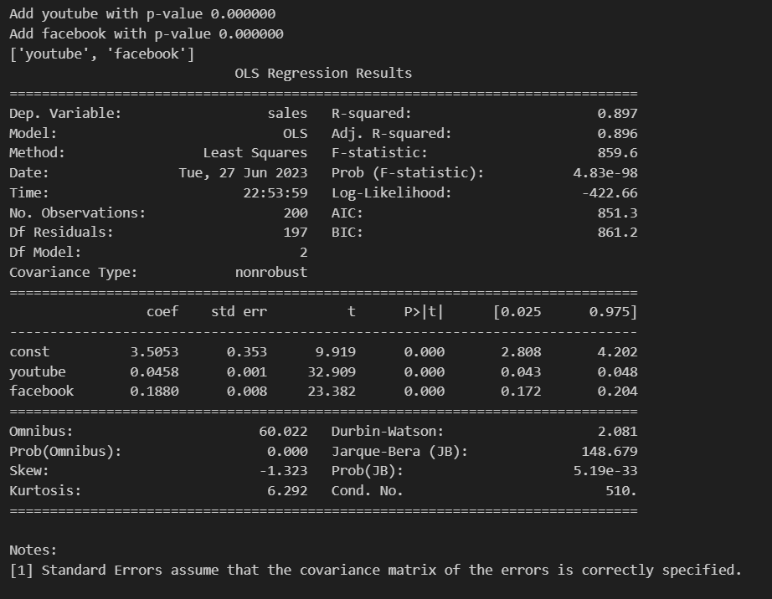
Stepwise selection
Variance Inflation Factor (VIF)
To identify multicollinearity in a multiple regression model.
To determine which variables are most affected by multicollinearity.
To decide whether to remove variables from the model or to find a way to reduce the correlation between the variables.

Slide 19
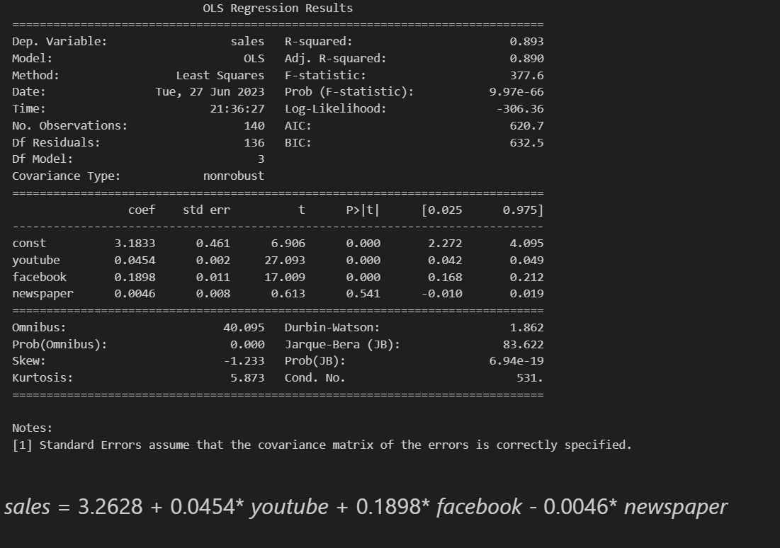
with 3 features

Slide 20
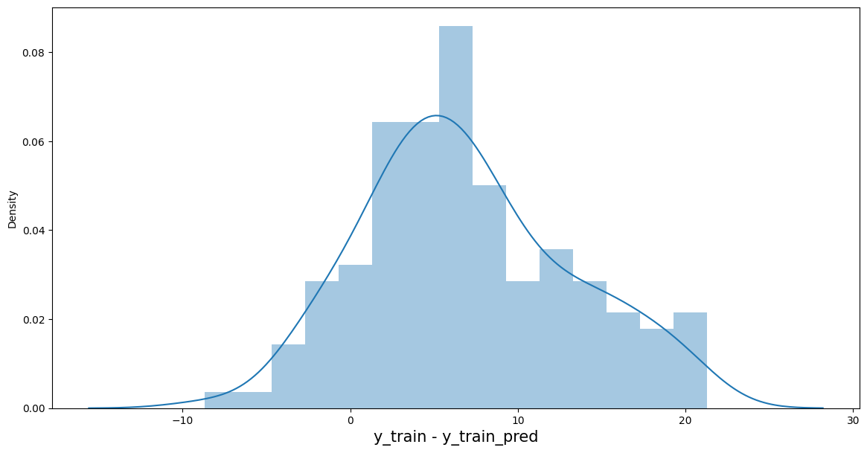
Error term
The risiduals are following the normally distributted not around 0. it is not good

Slide 21
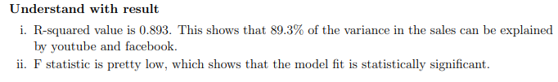
With 2 features

Slide 22
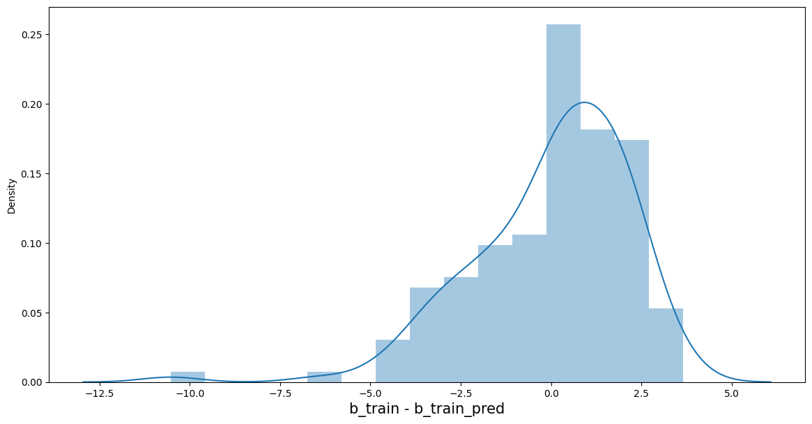
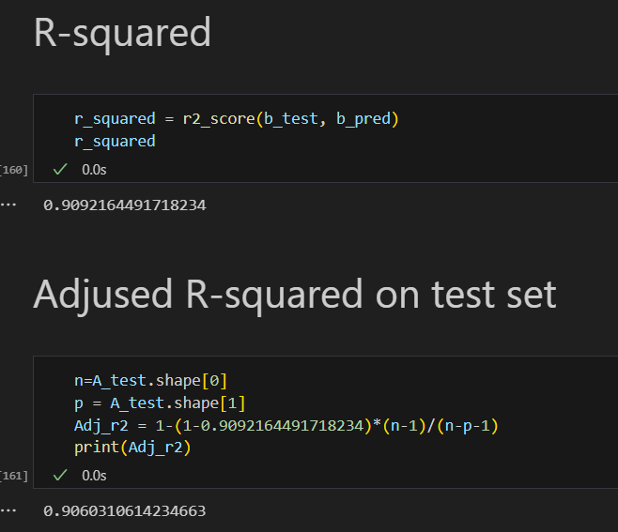

Slide 23
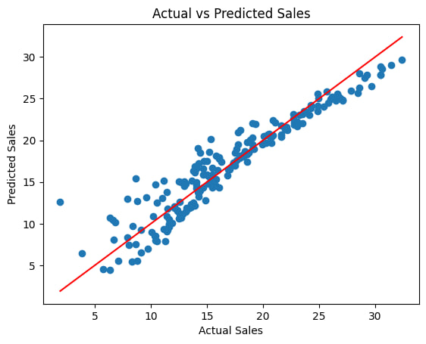

Slide 24
Interpreting our regression
We had all p-values in the multiple regression is p-value is lower than 0.05. and while checking on hypothesis test and ANOVA test p-values <0.05
A VIF of 1 indicates that there is no multicollinearity, while a VIF of 10 or higher indicates that there is severe multicollinearity, but when practice VIF in this project is less than 5 all (acceptable)
R-squared is pretty good 0.893 while R-squares on test set until 0.90
We got the error terms are normally distributed and center at 0 .

Slide 25
Conclusion
The regression equation sales = 3.2628 + 0.0455* youtube + 0.1925* facebook indicates that Facebook advertising has a positive effect on the company's sales, given the effects of YouTube and newspaper advertising. For every unit increase in Facebook advertising, sales are expected to increase by 0.1925 units, holding YouTube and newspaper advertising constant.
In other words, the regression results suggest that Facebook advertising is a significant predictor of sales, after controlling for the effects of YouTube and newspaper advertising. This means that Facebook advertising is likely to have a positive impact on sales, even when other factors that could affect sales are taken into account.

Slide 26

THANK YOU

